Slide 1
"Cookbook, but not a cookbook..."
By Edita

Slide 2
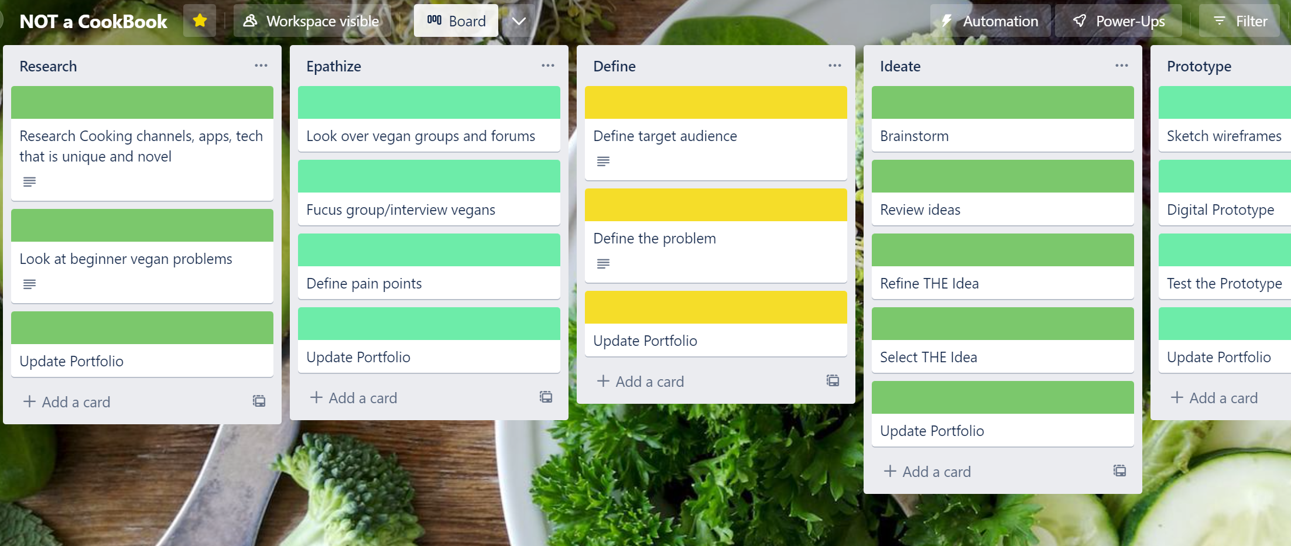
Design Thinking

Slide 3
Target Audience & Their Problems
🥕 Target Audience: Vegan Lifestyle Beginners 🥕
🤼 Peer pressure
🍲 Learning to cook again
🐇 Recognizing products that are vegan/cruelty free
Notes:
Research on trends, existing apps, channels and influencers. Talked with various people about their choices (Why, when, how was it?)
Peer pressure (negative reactions from people - close circle to complete strangers)
Learning to cook again (veganizing known recipes and learning new ones)
Recognizing products that are vegan/cruelty free

Slide 4
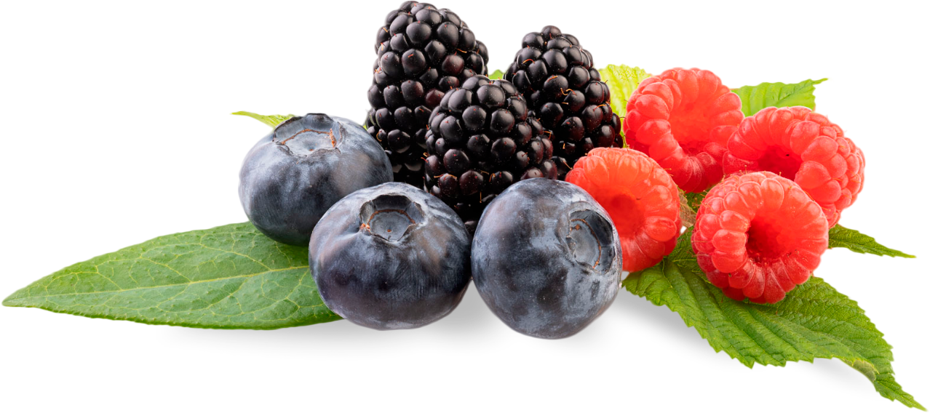
4 Ideas:
🐏 Apprenticeshaap
🌱 Vegan challenge app
🐧 Fridge App
🦉 Recipe “translator”
Notes:
I was told to “work on what I like” thus I will present the two ideas.

Slide 5
4 Ideas:
🐏 Apprenticeshaap
🌱 Vegan challenge app
🐧 Fridge App
🦉 Recipe “translator”
Notes:
I was told to “work on what I like” thus I will present the two ideas.

Slide 6
🐏 Apprenticeshaap
Sheep themed
Social and cooking aspects
Bringing old time vegans and beginners
Guidance and answers
Level system
Users endorse each other
Notes:
Level System (rep points for suggestions and their uses)

Slide 7
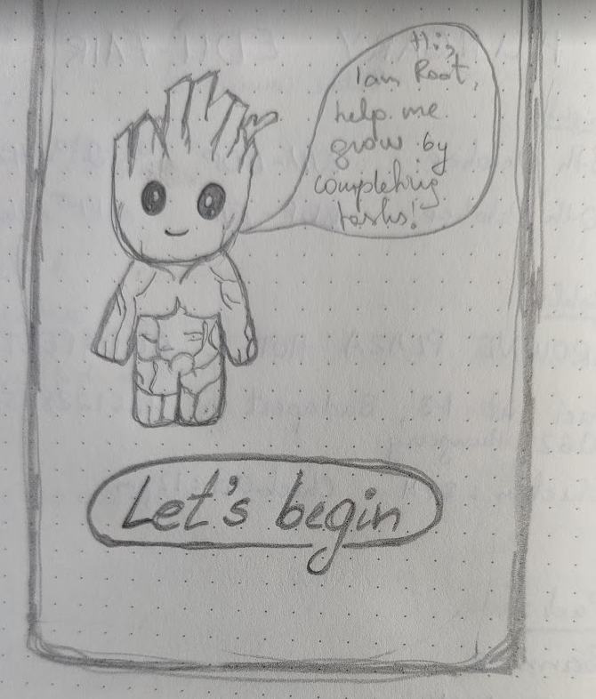
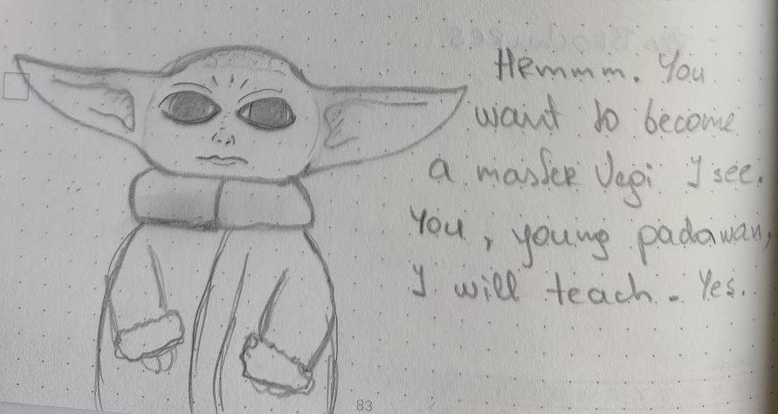
🌱 Vegan challenge app
Cooking challenges for beginners
Difficulty increases over time
Educational aspect and active involvement outside app
Personal journey log (proof images)
Tamagotchi style
Notes:
Teaches to cook, about processed stuff, how to combine meals and they can be similar to what people already know like burger or cheese: i.e., make vegan burger from beans, make vegan cheese from cashews and nutri-yeast etc Tree could grow with each completed challenge; Root could grow leaves; Yoda could give space rocks or sth.

Slide 8
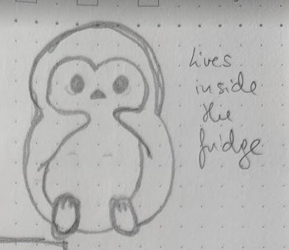
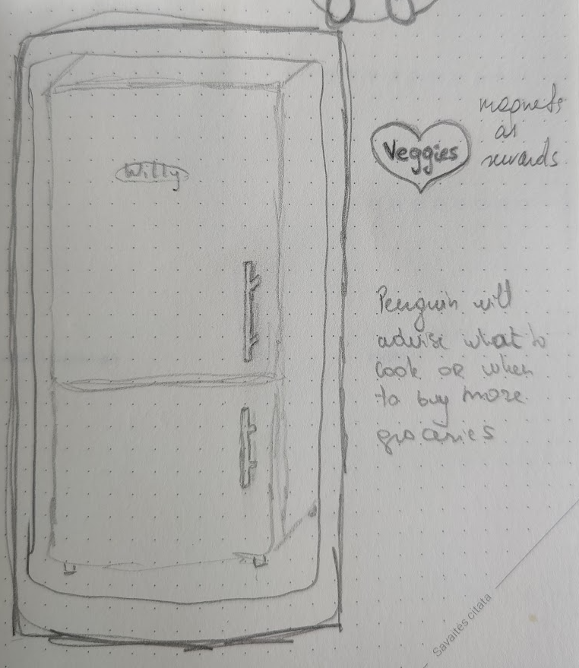
🐧 Fridge App
Input ingredients that you have
App will generate suggestions based on those ingredients
What about oils, seasoning, sauces, spices, herbs?
Perhaps most popular suggestions or sth?

Slide 9
🦉 Recipe “translator”
Input a recipe you want to use
The app will highlight non-vegan ingredients
Offer replacements
Users can add their replacements
Need to be reviewed and approved
Birds as levels based on suggestions

Slide 10
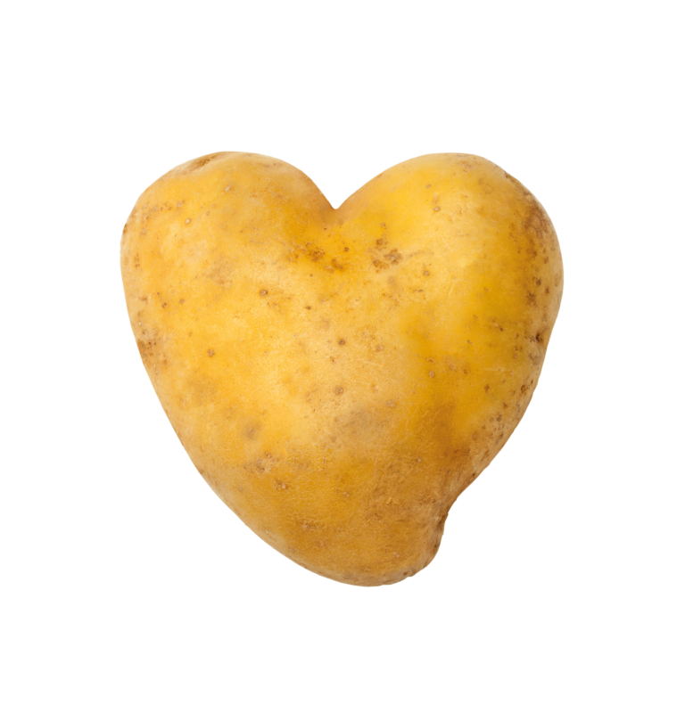
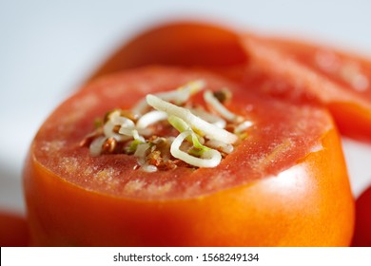
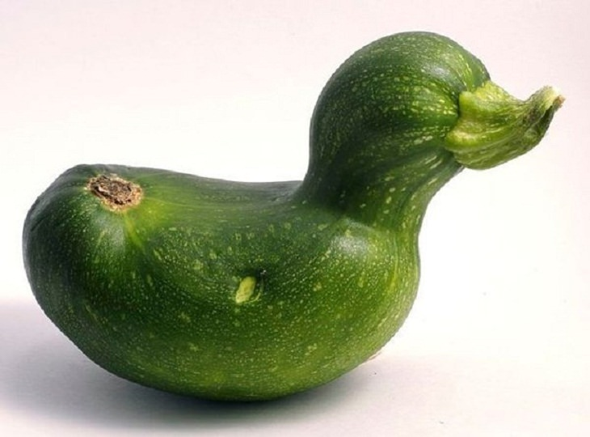
Feedback Please

Slide 11
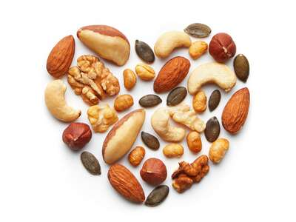
Thank You!

